Slide 1
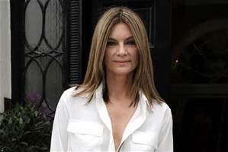
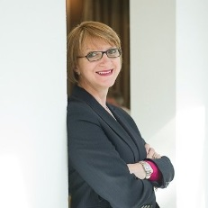
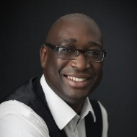
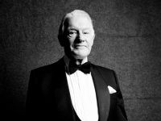
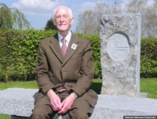
Knight/Dame: Made a big contribution, usually at national and international level, over a long period of time.
Commander of the Order of the British Empire (CBE): Prominent role at national level, leading role at regional level, or distinguished, innovative contribution.
Officer of the Order of the British Empire (OBE): Major regional role in any activity, which has been recognised nationally.
Member of the Order of the British Empire (MBE): Significant local achievement or outstanding services to the community. Also, for being a good role model for a local ‘hands-on’ service.
British Empire Medal (BEM): Sustained, local contribution or innovative, high-impact work of a relatively short duration, say 3-4 years.
HONOURS
Dame Natalie Massenet DBE, Internet Entrepreneur and Founder, Net-A Porter Group. For services to Fashion and Retail Industries
The different levels
Dr Nina Skorupska CBE
Chief Executive, Renewable Energy Association and Non Executive Director, Women in Science and Engineering Campaign. F or services to Renewables and Gender Equality in the Energy Industry
Joel Blake OBE
Founder, Cultiv8 and Co-founder, HOT500. For services to Business Support and Enterprise
Angus Cundey MBE, Chairman, Henry Poole & Co. For services to the Bespoke Tailoring Trade and Tailor Charities
Harry Parkes BEM
For services to the Bevin Boys and wartime service recognition

Slide 2
TOP 10 TIPS FOR WRITING A CITATION
1
Write in plain English and don’t use jargon.
2
Start with a strong sentence, summarising the overall case. For example, ‘He made significant changes, saving £100,000 by restructuring the charity’.
3
Keep it relevant by answering the questions: What was the situation before their involvement? What did they do? What was the result?
4
Make sure it is up-to-date; record the last five years’ achievements and impact.
5
Don’t include career or school history, it’s not a CV.
6
Use no more than three recent examples.
7
Focus on impact and achievement; back this up with facts and figures.
8
Explain how they have made a contribution beyond what would be expected of their paid role.
9
Make it interesting.
10
The whole form (including the information boxes) must fit on one A4 page

